Slide 1
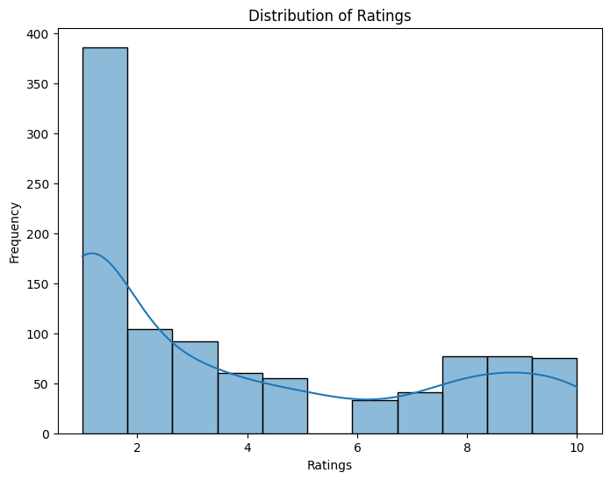
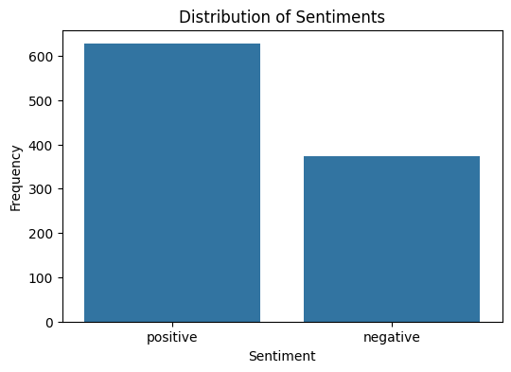
Key Findings
Top Areas of Concern :
Cabin Crew: Frequently mentioned in low-rated reviews (1-2), suggesting dissatisfaction.
Food: Often criticized in low ratings, with keywords like "bad experience" and "poor quality."
Seat Comfort: Words like "middle seat," "economy seats," and "cramped" appear in low-rated reviews.
Overall Passenger Rating:
Average rating: 3.93/10, showing a general dissatisfaction.
Ratings are skewed toward the lower end, indicating widespread complaints.
Frequent Across Reviews:
Negative mentions: “Delayed” (138 mentions), “Poor” (116 mentions), “Rude” (45 mentions)
Positive mentions: "Comfortable" (146 mentions), "Excellent" (72 mentions), "Delicious" (10 mentions)
→Improving cabin crew service, food quality, and seat comfort can significantly boost ratings, increase profits and may improve airline perception.

Slide 2
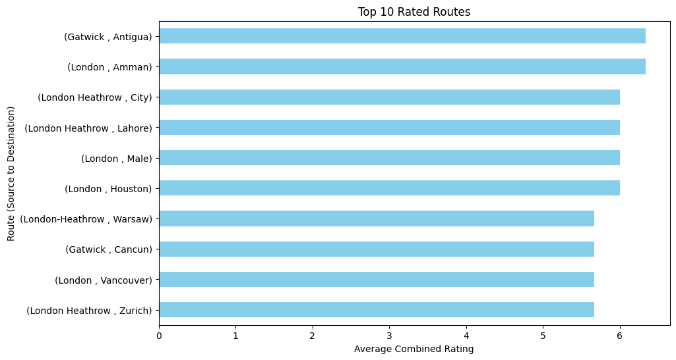
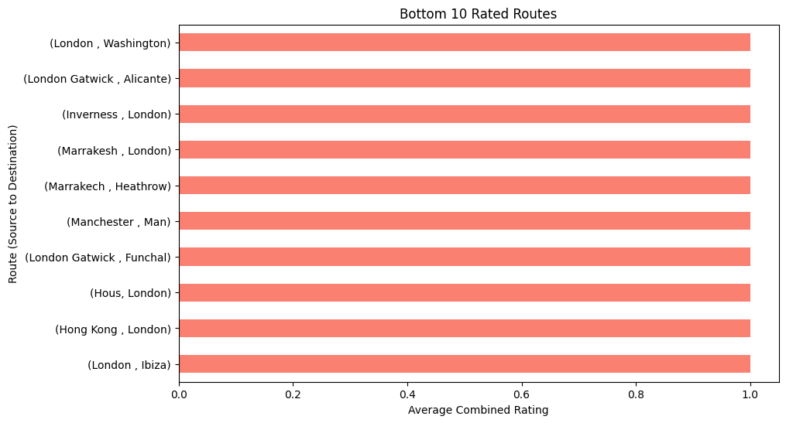
Top 10 Rated Routes (Avg Rating 6.3/10)
Long-haul flights to tourist destinations tend to have higher ratings.
Routes with premium service options receive better scores.
Bottom 10 Rated Routes (Avg Rating 1.0/10)
Short-haul European routes and some Long-haul routes receive very low ratings, likely due to delays, lack of service, or customer dissatisfaction.
London-based departures dominate both lists, suggesting mixed service quality.
→Better customer experience on low-rated short-haul routes is crucial for reputation.

